Slide 1
Report about ‘Car-Accident-Severity’ on Data Science Basis
Huijie Hu
2020.9.7

Slide 2

1. Business Understanding
1.1 About Seattle
Location & Economics
1.2 About Car Accident
1.3 Problem

Slide 3
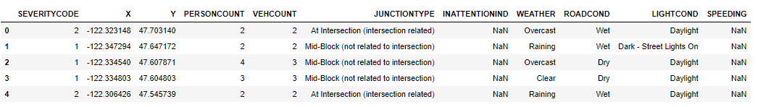
2. Data Access & Data Wrangling
2.1 Import Libraries
2.2 File Handling
2.3 Data Selection

Slide 4
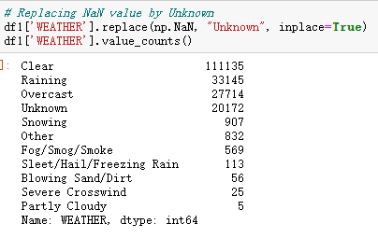
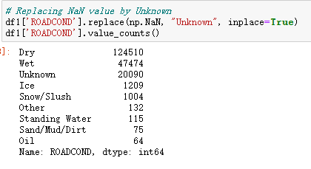
2. Data Access & Data Wrangling
2.4 Fix Missing Values

Slide 5
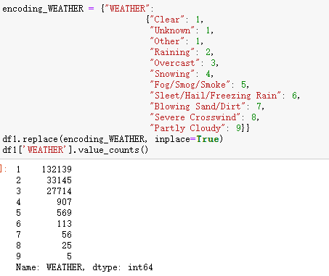
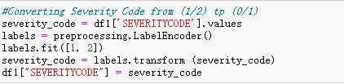
2. Data Access & Data Wrangling
2.5 Binary & Encoding

Slide 6
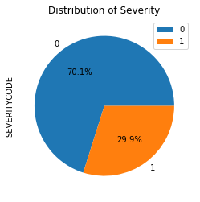
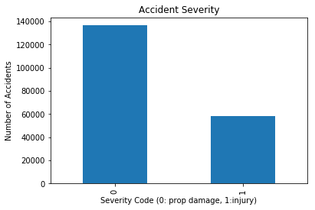
3. Exploratory Data Analysis
3.1 Basic Data Visualization
In this sector, we provide some basic data visualization. Because we just did encoding and binary firstly, there is no text in following charts.

Slide 7
4. Modeling & Evaluation
4.1 Machine Learning Preparation
Machine learning models here used are K-Nearest Neighbors, Decision Tree Analysis and Logistic Regression. These methods vary from each other.
Decision Tree Analysis Model use entropy to set the whole dataset to different branches based on different depths. It comes up with leaf nodes and decision nodes. KNN is a regression model based on the k-distance, which is the parameter set manually. Logistic Regression is a static model based on binary variables.
4.2 Data Normalization

Slide 8
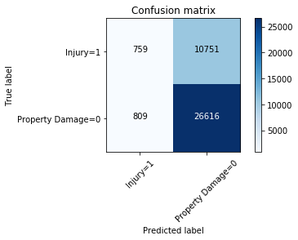
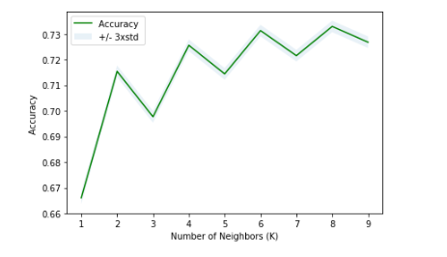
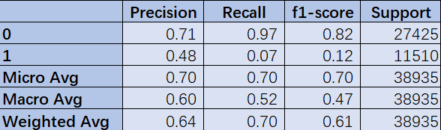
4. Modeling & Evaluation
4.3 K-Nearest Neighbors

Slide 9
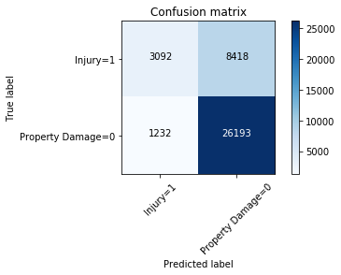
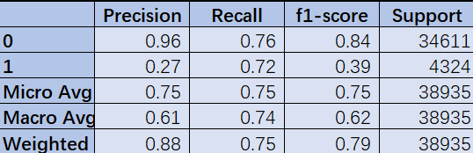
4. Modeling & Evaluation
4.4 Decision Tree

Slide 10
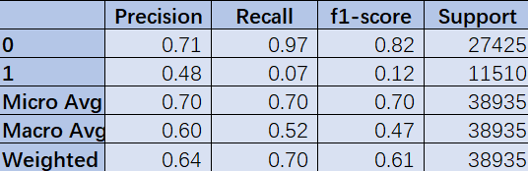
4. Modeling & Evaluation
4.5 Logistic Regression

Slide 11
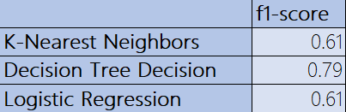
5. Evaluation
5.1 f1-score
F1-score is a symbol of accuracy of the model that we deployed. The closer between 1 and f1-score, the more precise the model is.

Slide 12
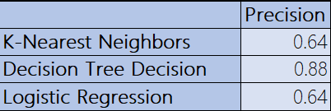
5. Evaluation
5.2 Precision
This is an output that weighs the relevance. It is calculated by dividing true positives by true positives and false positives.

Slide 13
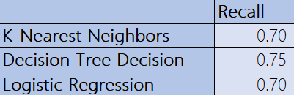
5. Evaluation
5.2 Recall
Recall gives us information about percentage of total relevant results correctly classified by our algorithm. .

